Slide 1
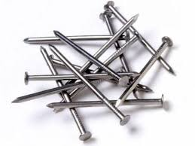

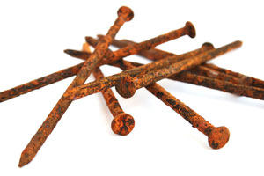

Chemical kinetics
Unit -2
Understanding the interactions and energy changes
in a chemical reaction at molecular level
Real life examples
Note: Some images and materials are taken from different sources and this is purely for educational purposes and not to be distributed anywhere other than where and whom it is intended for.

Slide 2
What is Kinetics?
Studies the rate at which a chemical process occurs.
Besides information about the speed at which reactions occur, kinetics also sheds light on the reaction mechanism (exactly how the reaction occurs).

Slide 3
Why do we study kinetics?
Productivity and resource utilization
Energy and environment
Societal: science in service of humanity
competitiveness

Slide 4
Integration
Reaction Dynamics
Theories of Reaction
Rate of Reaction
Concentration
Temperature
Catalyst
Zero Order
First Order
Second Order
Pseudo First Order
Role of a catalyst
Enzyme Catalysis
Arrhenius Equation

Slide 5
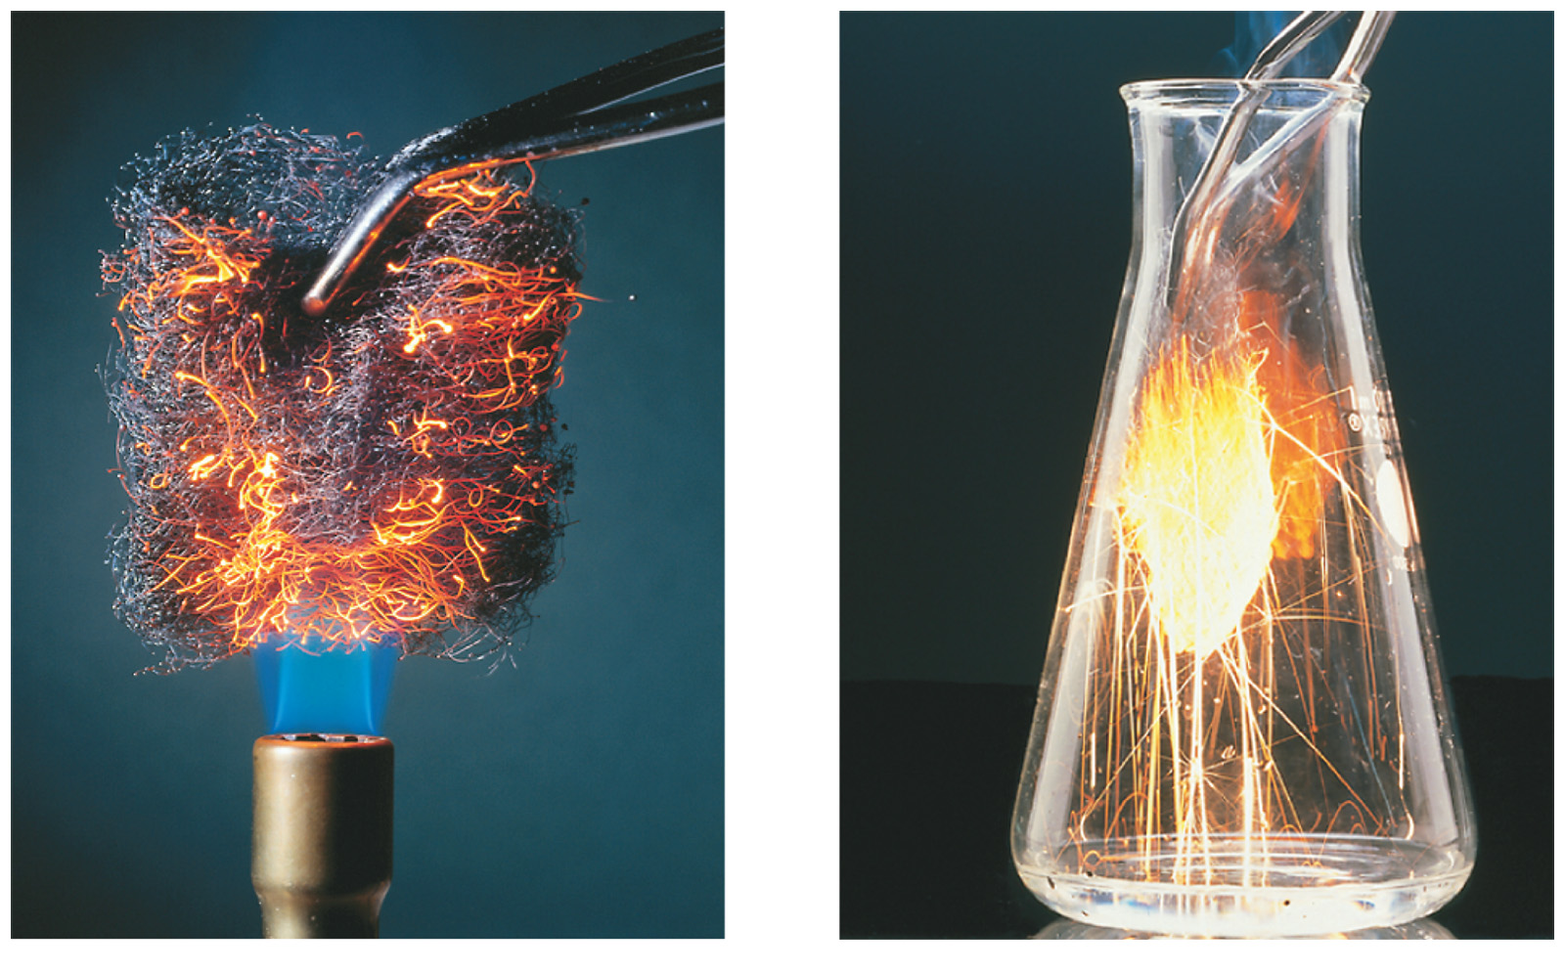
Factors That Affect Reaction Rates
Concentration of Reactants
As the concentration of reactants increases, so does the likelihood that reactant molecules will collide.
Temperature
At higher temperatures, reactant molecules have more kinetic energy, move faster, and collide more often and with greater energy.
Catalysts
Speed rxn by changing mechanism.

Slide 6
Methods to determine order and rate constant

Slide 7
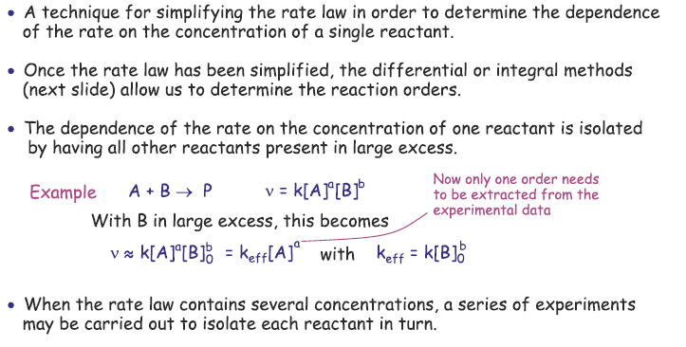
Determining the rate law and order from experimental data
1. Isolation method (method of flooding )
The reaction is performed with all species but one in excess. Under these conditions, only the concentration of one species will vary to a significant extent during the reaction.
R = k’[B]^{β}

Slide 8
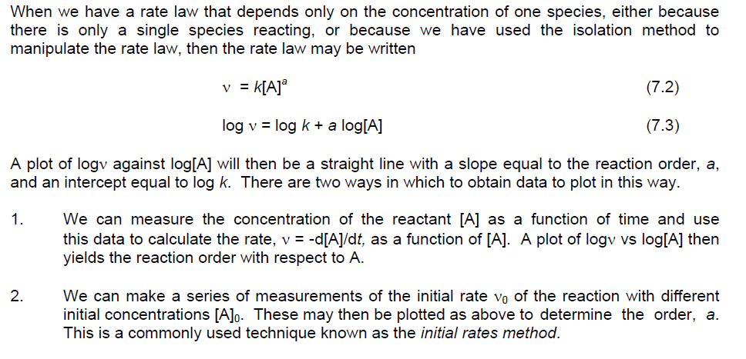
Determining the rate law and order from experimental data
2. Differential methods (Initial rate method)
The concentration of a single reactant is changed while holding all other concentrations constant, and the initial rate of the reaction is determined.

Slide 9
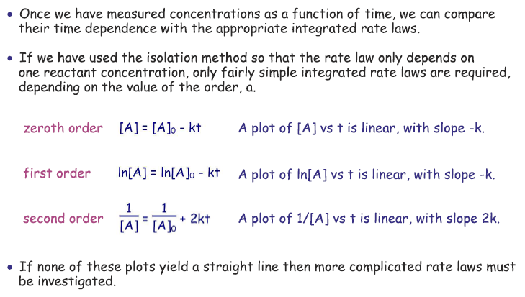
Determining the rate law and order from experimental data
3. Integral methods

Slide 10
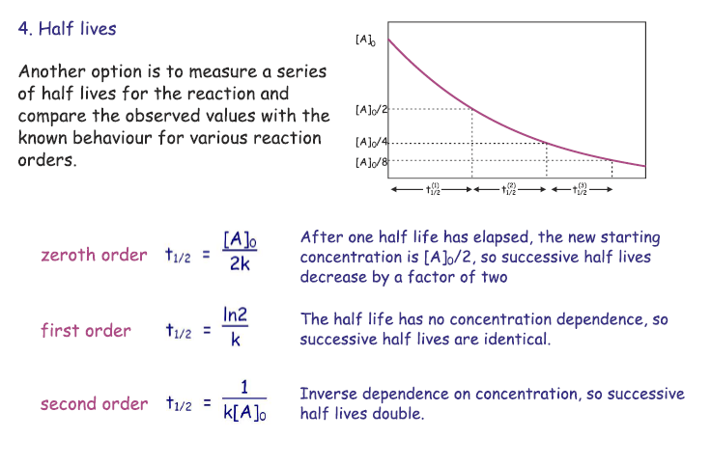
Determining the rate law and order from experimental data
4. Half life methods

Slide 11
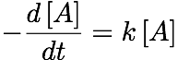
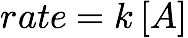
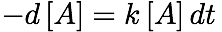
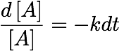
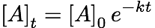
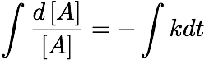
First-Order Processes
Integrated Rate Laws
Consider a simple 1st order rxn: A B
Differential form:
How much A is left after time t? Integrate:

Slide 12
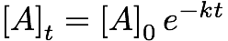
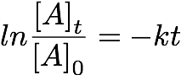
Integrated Rate Laws
The integrated form of first order rate law:
Can be rearranged to give:
[A]₀ is the initial concentration of A (t=0).
[A]_{t} is the concentration of A at some time, t, during the course of the reaction.

Slide 13
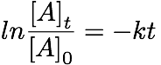
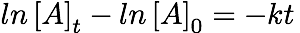
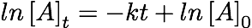
Integrated Rate Laws
Manipulating this equation produces…
…which is in the form
y = mx + b
If a reaction is first-order, a plot of ln [A]_{t} vs. t will yield a straight line with a slope of -k.
So, use graphs to determine rxn order.

Slide 14
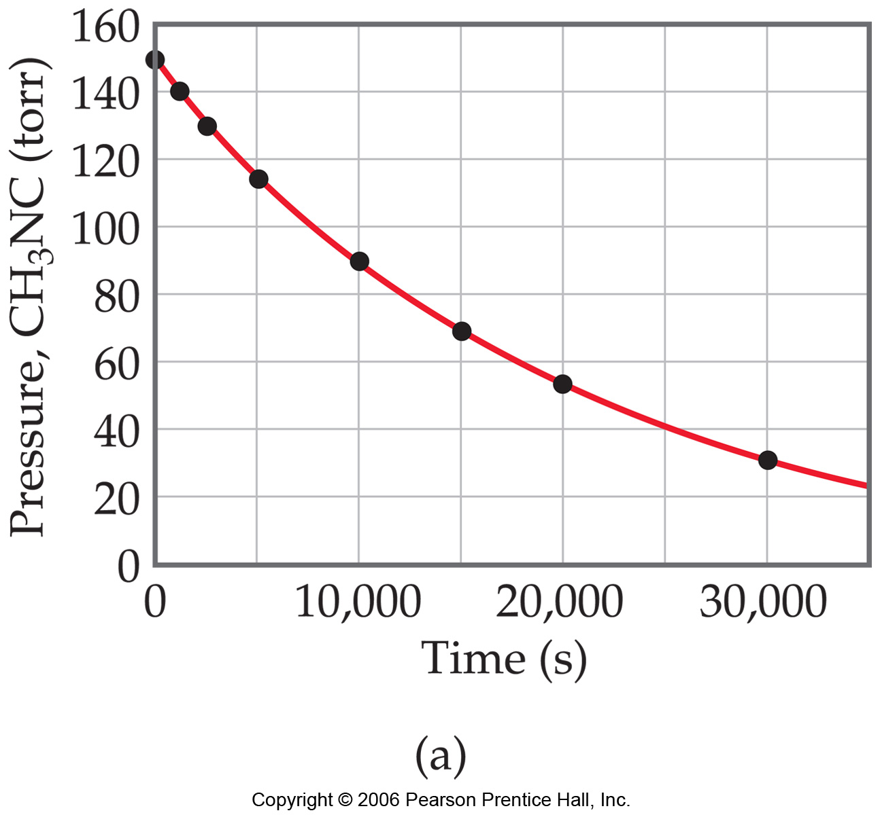
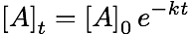
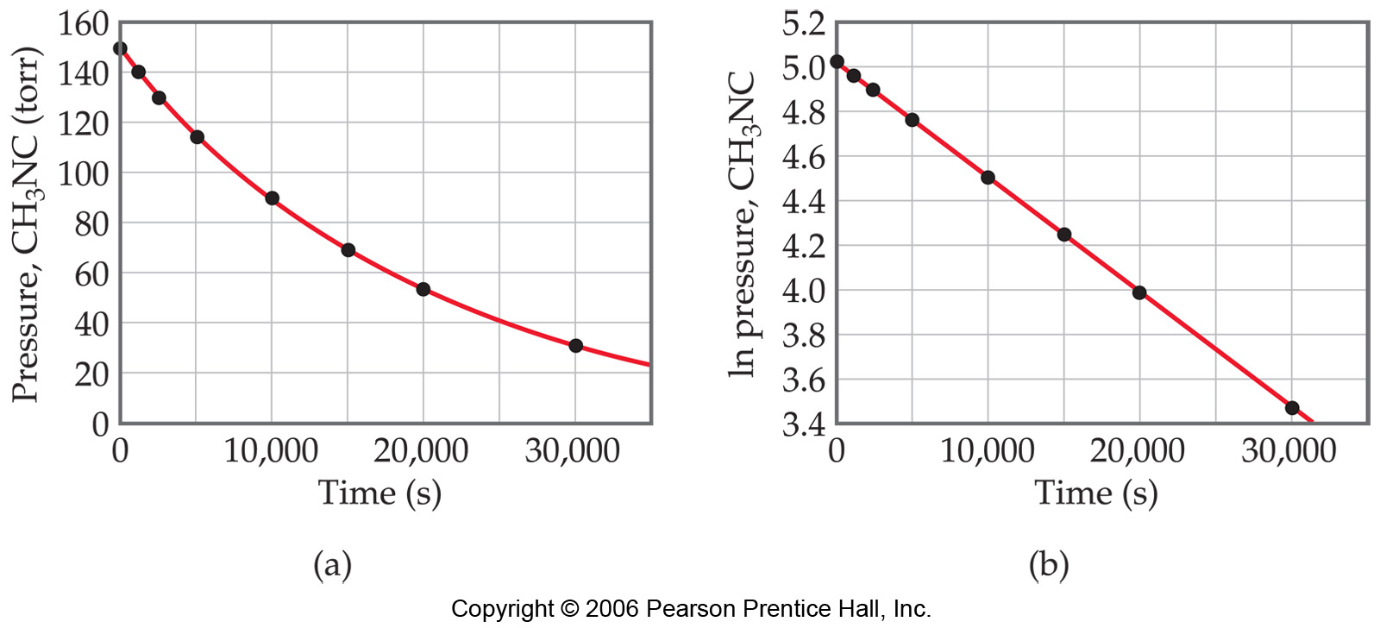
First-Order Processes: Examples
Consider the process in which methyl isonitrile is converted to acetonitrile.
CH₃NC
CH₃CN
How do we know this is a first order rxn?
This data was collected for this reaction at 198.9°C.
Does
rate=k[CH₃NC]
for all time intervals?
When ln P is plotted as a function of time, a straight line results.
The process is first-order.
k is the negative slope: 5.1 × 10⁻⁵ s⁻¹.

Slide 15
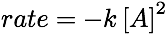
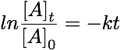
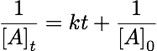
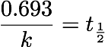
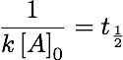
Outline: Kinetics
 | First order | Second order | Second order
Rate Laws
Integrated Rate Laws |  |  | complicated
Half-life |  |  | complicated
2

Slide 16
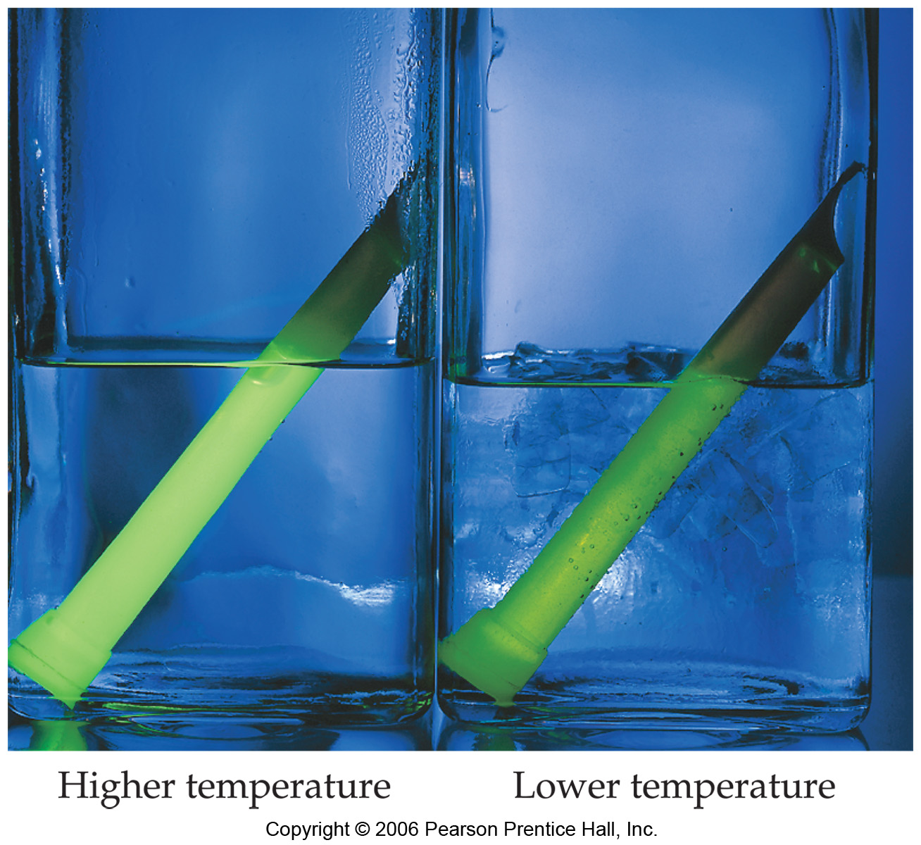
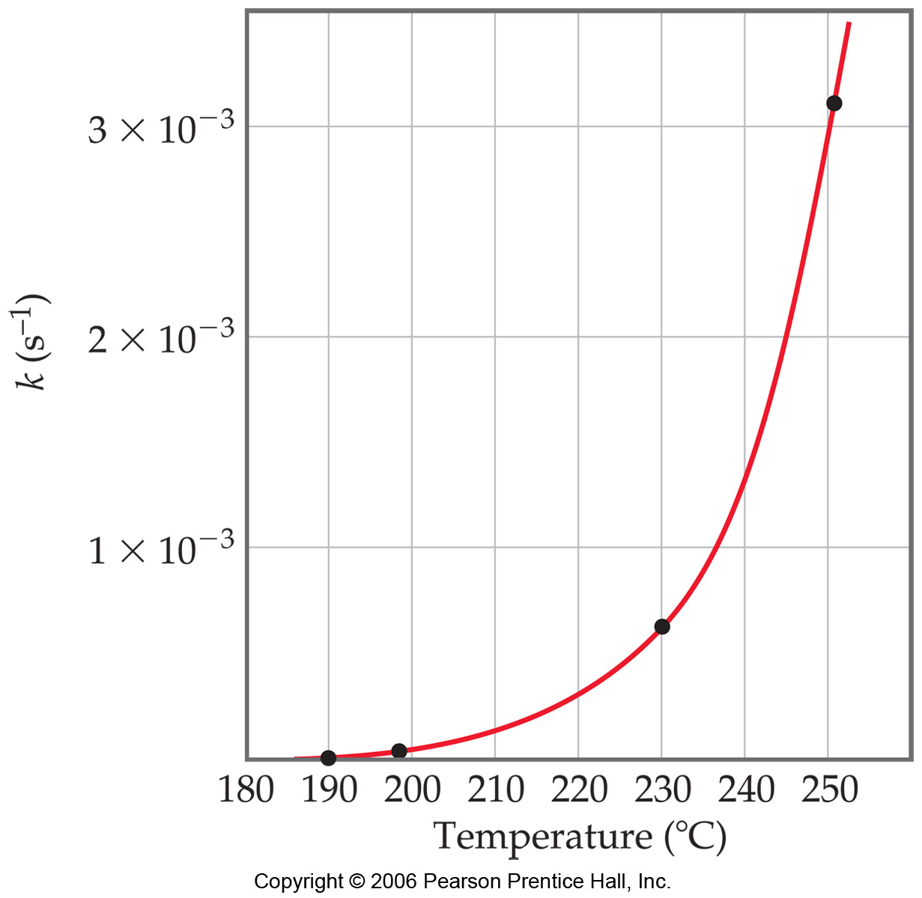
Temperature and Rate
Generally, as temperature increases, so does the reaction rate.
This is because k is temperature dependent.

Slide 17
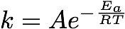
Arrhenius Equation
Temperature and Rate
Svante Arrhenius developed a mathematical relationship between k and E_{a}:
where A is the frequency factor, a number that represents the likelihood that collisions would occur with the proper orientation for reaction.

Slide 18
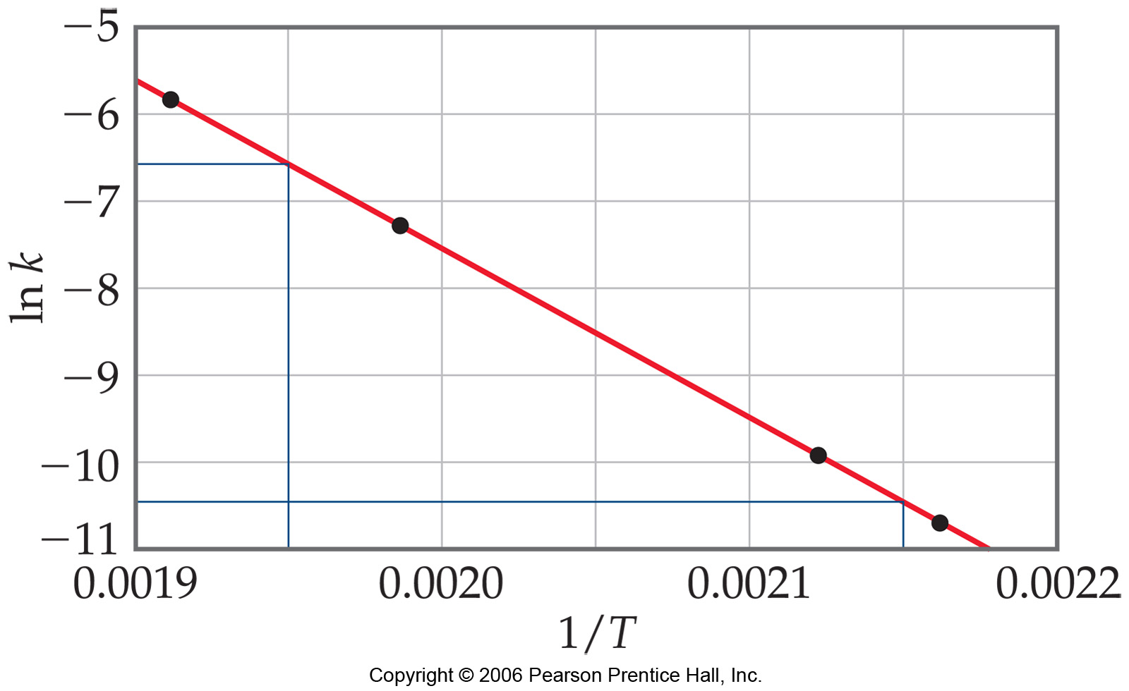
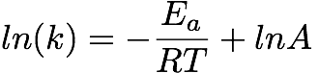
Arrhenius Equation
Temperature and Rate
Taking the natural logarithm of both sides, the equation becomes
y = mx + b
When k is determined experimentally at several temperatures, E_{a} can be calculated from the slope of a plot of ln k vs. 1/T.

Slide 19
Experimental determination of activation energy
k = Ae^{-Ea/RT}
If we know take the natural log of the above equation: ln k = ln A - (Ea/RT)
by just rewriting this slightly differently we get: ln k = (-Ea/R)(1/T) + ln A
which is in fact the equation of a straight line that relates the natural logarithm of k to the inverse of the temperature. Thus if one were to plot ln k vs 1/T, one should obtain a straight line with a negative slope. The slope of this line is equal to -Ea/R and the intercept ln A.
This is the heart of this experiment. Determine k at four different temperatures and by doing the appropriate plot determine the activation energy for this reaction.
Experiment: Mix reactants and record the time it takes to complete the chemical reaction at a certain temperature. Repeat the procedure with another sample at this temperature. Using the average time, determine k at this temperature. Repeat this procedure for the other suggested temperatures. When complete, determine the Activation Energy by plotting ln k v 1/T.

Slide 20
The Collision Model
In a chemical reaction, bonds are broken and new bonds are formed.
Molecules can only react if they collide with each other.
According to collision theory
Rate of a chemical reaction (r)
r = (encounter rate) (energy requirement) (steric requirement)

Slide 21
The Collision theory
Consider the elementary gas-phase reaction A + B → products
1. Encounter rate
The number of collisions per second per unit volume between gas molecule A and gas molecule B depends on their concentration:
Z_{AB} = α CACB
For ideal gases α may be predicted from the kinetic theory of gases.
2. Energy requirement
For a Maxwell-Boltzmann distribution of molecular speeds, the fraction of collisions for which the energy is high enough to overcome the activation barrier is exp(-Ea/RT).

Slide 22
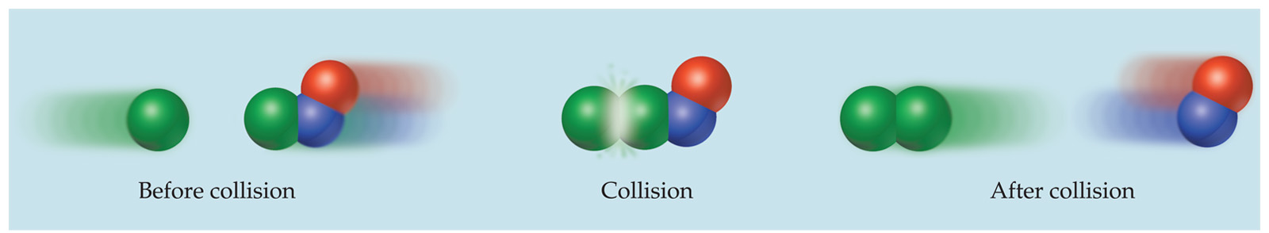
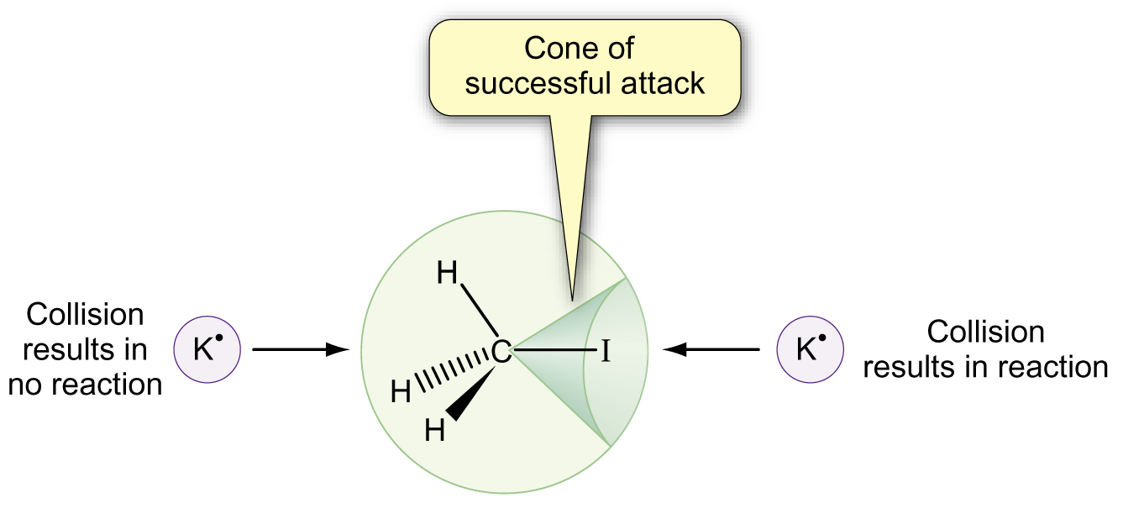
The Collision theory
3. Steric requirement
Furthermore, molecules must collide with the correct orientation and with enough energy to cause bond breakage and formation.

Slide 23
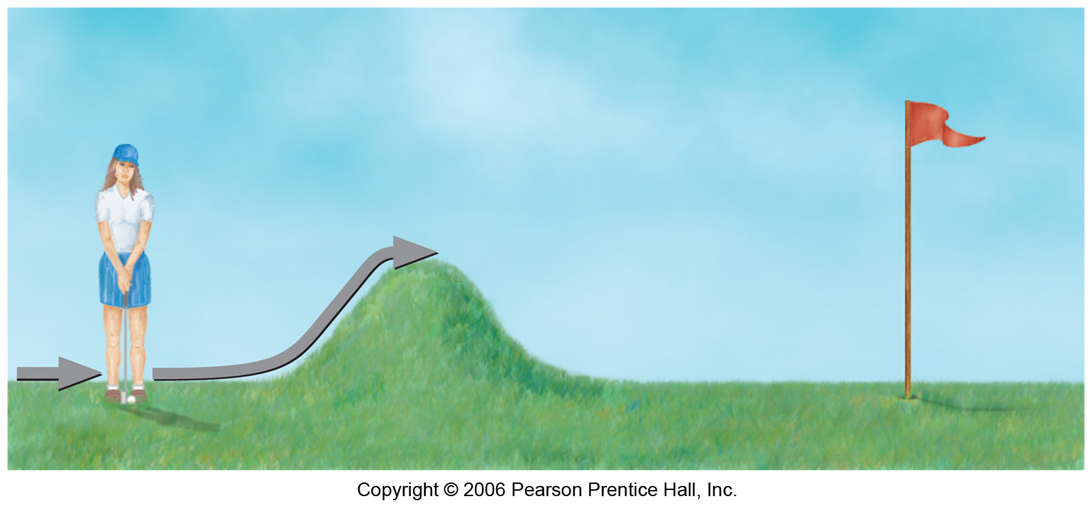
Activation Energy
In other words, there is a minimum amount of energy required for reaction: the activation energy, E_{a}.
Just as a ball cannot get over a hill if it does not roll up the hill with enough energy, a reaction cannot occur unless the molecules possess sufficient energy to get over the activation energy barrier.

Slide 24
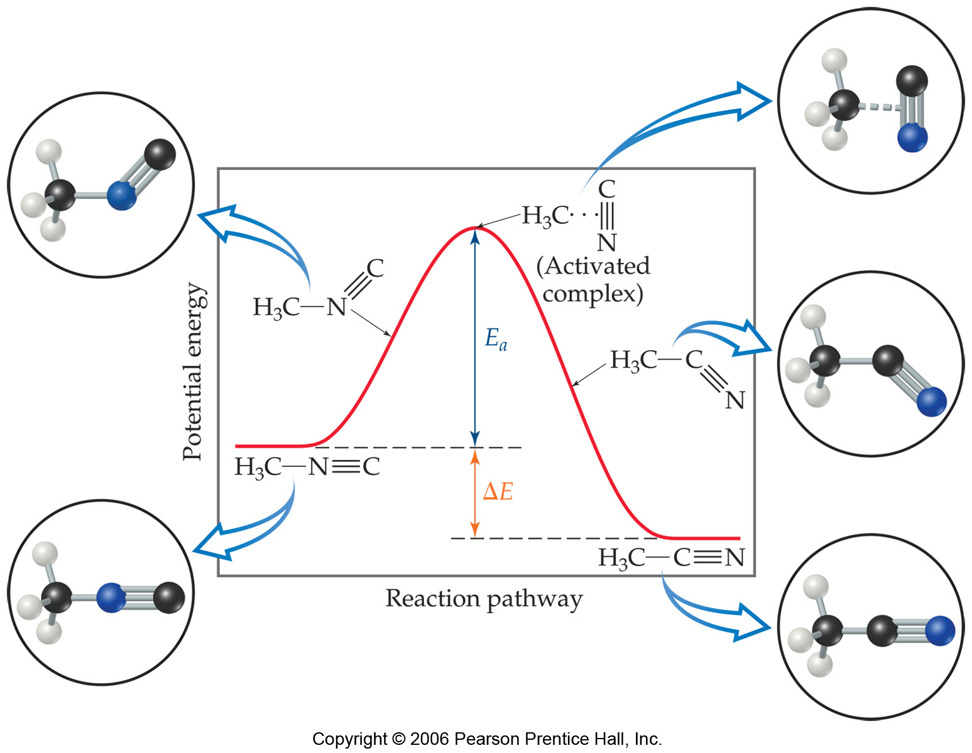
Reaction Coordinate Diagrams
It is helpful to visualize energy changes throughout a process on a reaction coordinate diagram like this one for the rearrangement of methyl isonitrile.

Slide 25
Reaction Coordinate Diagrams
It shows the energy of the reactants and products (and, therefore, ΔE).
The high point on the diagram is the transition state.
The species present at the transition state is called the activated complex.
The energy gap between the reactants and the activated complex is the activation energy barrier.

Slide 26
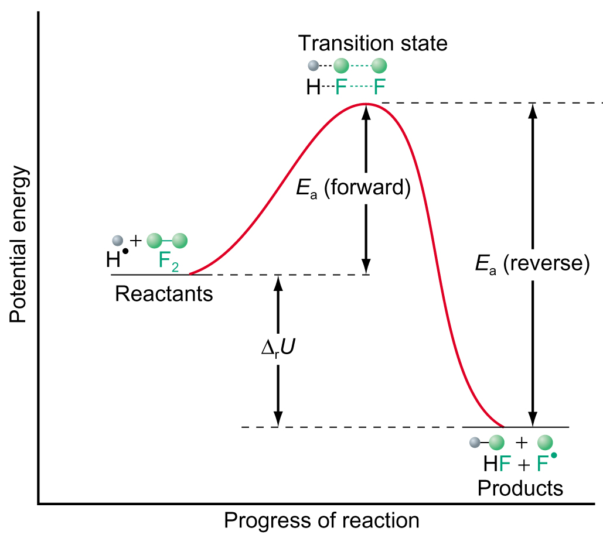
Reaction Coordinate Diagrams
Or ΔH (heat of reaction)

Slide 27
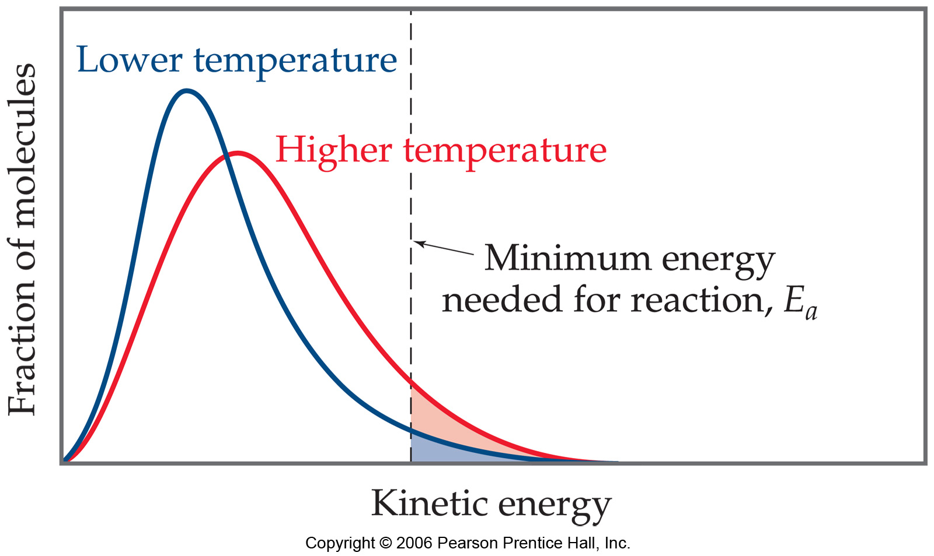
Maxwell–Boltzmann Distributions
Temperature is defined as a measure of the average kinetic energy of the molecules in a sample.
At any temperature there is a wide distribution of kinetic energies.
As the temperature increases, the curve flattens and broadens.
Thus at higher temperatures, a larger population of molecules has higher energy.
If the dotted line represents the activation energy, as the temperature increases, so does the fraction of molecules that can overcome the activation energy barrier.
As a result, the reaction rate increases.

Slide 28
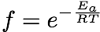
Maxwell–Boltzmann Distributions
This fraction of molecules can be found through the expression:
where R is the gas constant and T is the temperature in Kelvin .

Slide 29
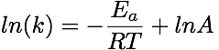
Outline: Kinetics
 | First order | Second order | Second order
Rate Laws
Integrated Rate Laws |  |  | complicated
Half-life |  |  | complicated
k(T)
2

Slide 30
Complex reactions: Reaction Mechanisms
The sequence of events that describes the actual process by which reactants become products is called the reaction mechanism.

Slide 31
Reaction Mechanisms
Rules:
Sum of elementary steps gives the overall reaction
The slowest steps in the mechanism constitutes the rate determining steps.
The overall rate law must be consistent with the observed rate law.

Slide 32
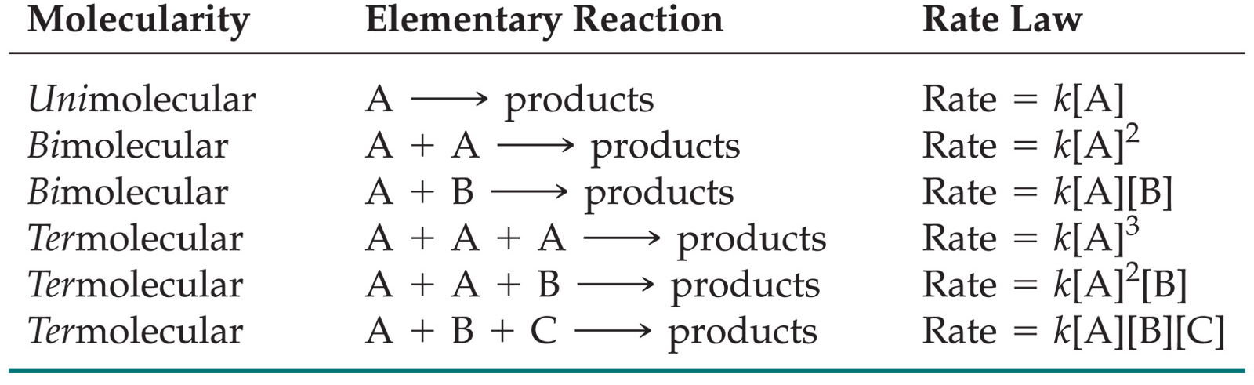
Reaction Mechanisms
The molecularity of a process tells how many molecules are involved in the process.
The rate law for an elementary step is written directly from that step.

Slide 33
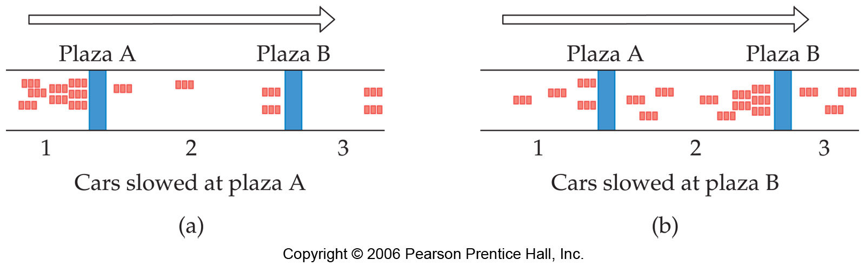
Multistep Mechanisms
In a multistep process, one of the steps will be slower than all others.
The overall reaction cannot occur faster than this slowest, rate-determining step.

Slide 34
Slow Initial Step
NO₂ (g) + CO (g) NO (g) + CO₂ (g)
The rate law for this reaction is found experimentally to be
Rate = k [NO₂]²
CO is necessary for this reaction to occur, but the rate of the reaction does not depend on its concentration.
This suggests the reaction occurs in two steps.

Slide 35
Slow Initial Step
A proposed mechanism for this reaction is
Step 1: NO₂ + NO₂ NO₃ + NO (slow)
Step 2: NO₃ + CO NO₂ + CO₂ (fast)
The NO₃ intermediate is consumed in the second step.
As CO is not involved in the slow, rate-determining step, it does not appear in the rate law.

Slide 36
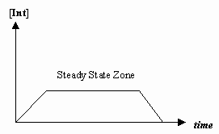
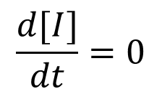
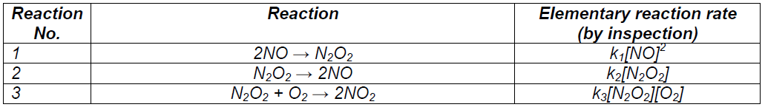
Approaches for expressing [Intermediate] in terms of [Reactants]
Steady state approximation
Steady state approximation: Assumes concentration of intermediates remains constant
= rate of appearance - rate of disappearance
Using steady state determine the overall rate expression
Examples:
Net reaction: 2NO+O₂ = 2NO₂
Continue….next slides

Slide 37
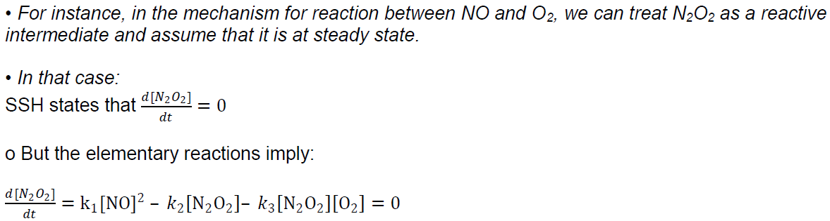
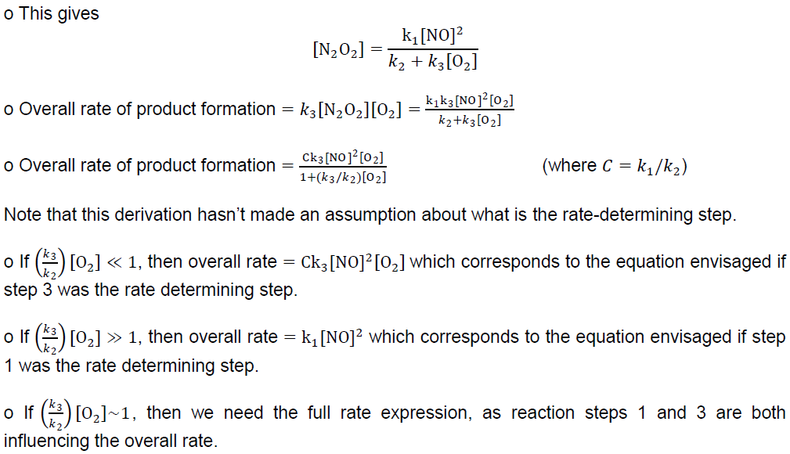

Slide 38
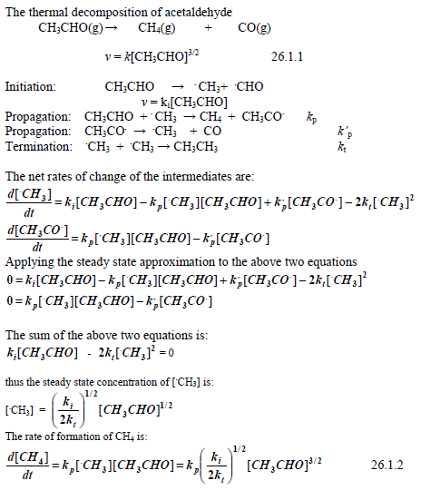
Applying steady states: Thermal decomposition of CH3CHO
You are advised to practice more problems using steady state from tutorial

Slide 39
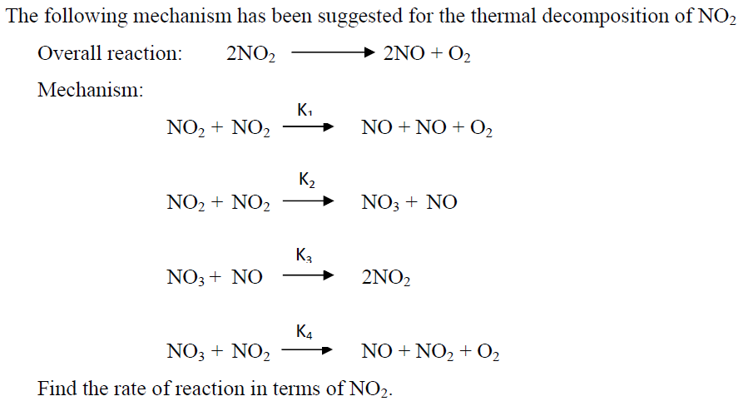
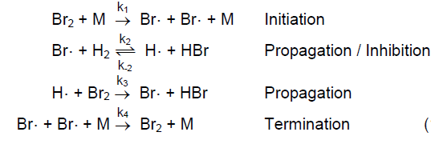
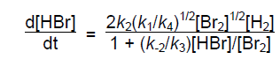
Home work-1
Home work-2
Using steady state prove that

Slide 40
Unimolecular Decompositions
Lindemann theory
An example of
Mechanisms, Steady State Approximation,
and Elementary Reactions
A → Fragments
Observed Experimentally to
be first order in pyrazine.
pyrazine

Slide 41
Lindemann theory
or C - B → C + B with
Lindemann [Lord Cherwell] suggested the following mechanism:
Assume, however, that after A* is produced by a collision it hangs around for some time before decomposing. This time lag between activation and reaction may be thought of as the time necessary to transfer energy among the internal (vibrational) coordinates.

Slide 42
Lindemann theory
k₂ is decomposition step assumed irreversible.
Mechanism Elementary Steps:
Step 1
Step 2
Step 3
Don’t know what [A*] is, however the number of [A*] must be small
or the reaction would go to completion very quickly. A* is a
“bottleneck” for the reaction since product is only formed via A*.

Slide 43
Lindemann theory
The Steady State
Approximation
d[A*]/dt = 0 = k₁[A]²-k₋₁[A*][A]-k₂[A*]
Solve for [A*] →
Steady state approach allows us to solve for concentration
of unknown species [A*] in terms of known [A] concentration.
Fundamental result of
Lindemann “Unimolecular
Reaction Mechanism”
Note, multistep mechanism leads to complex rate expression!

Slide 44
Lindemann theory
Two Limiting Cases
I) Case-I
k₂>>k₋₁[A]
This says the rate of decomposition of A* is much faster
than the rate of deactivation.
Thus, dP/dt ≅ k₁[A]² }2nd order in [A]
At this point, it looks like Mr. Lindemann will have to hand
in his Theorists’ Club ID card since his scheme seems to
predict a second order kinetic dependence on [A]²!

Slide 45
“Physical Interpretation” of this particular limit:
Case-I
k₂>>k₋₁[A]
Mechanism Elementary Steps:
Step 1
Step 2
Step 3
Reaction rate here is just the rate at which [A*] is formed since
every A* formed falls apart to product P immediately. The rate of
formation of A* is obtained from the first step: d[A*]/dt = k₁[A]²
So the reaction becomes a simple binary collison model, second
order process in this limit.

Slide 46
(Case II)
This says there is an appreciable time lag between activation and
reaction. Thus, a large amount of deactivation occurs.
Note that k₋₁ [A] is pressure dependent. Gets larger as pressure
increases {P_{A}=(n_{A}/V)RT = [A]RT}. Thus, k₋₁ [A] >> k₂ is a good
approxmation at high pressures.
1st order in A (apparent)
[More careful investigation of “unimolecular” decomp. showed 2nd
order kinetics at low pressure.]

Slide 47
“Physical Interpretation” of this particular limit:
k₂<<k₋₁[A]
Mechanism Elementary Steps:
Step 1
Step 2
Step 3
Reaction rate here is dP/dt = k₂ [A*] but the concentration of A*
is given by the “equilibrium” condition, k₋₁[A*][A] = k₁[A]². So,
solving for [A*] gives:
Result is that [A*] scales linearly with [A] and rate, dP/dt = k₂[A*]
also scales linearly with [A].

Slide 48
Kinetics of reversible reactions
k₁
CH₃NC
CH₃CN
k₋₁
see your class note

Slide 49


Kinetics of reversible reactions

Slide 50

Kinetics of parallel reactions
k₁
H+O₂
HO + O
k₂
HO₂

Slide 51

Kinetics of parallel reactions

Slide 52








Kinetics of consecutive reactions
k₁
k₂
A
B
C
For deviation of [A], [B] and [C], see your class note

Slide 53

Catalysts
Catalysts increase the rate of a reaction by decreasing the activation energy of the reaction.
Catalysts change the mechanism by which the process occurs.

Slide 54
Practice problem-1
For the following reaction H₂ (g) + I₂ (g) → 2 HI (g), the initial rate of formation of hydrogen iodide was found to be 3.2 × 10⁻³ mol dm⁻³ s⁻¹. What is the initial rate of consumption of H₂?
1.6 × 10⁻³ mol dm⁻³ s⁻¹.
Feedback: Correct. Use the stoichiometric equation to determine the relationship between the number of moles of HI formed relative to the number of moles of H₂ and I₂ consumed in the reaction. The initial rate of formation of HI = 2 × initial rate of consumption of H₂. Thus, the initial rate of consumption of H₂ =1/2 × initial rate of formation of HI.

Slide 55


Practice problem-2

Slide 56

Solution to Practice problem-2

Slide 57



Practice problem-3

Slide 58


Practice problem-4

Slide 59
Practice problem-5

Slide 60

Practice problem-6

Slide 61
Practice problem-7
Determination of Rate Law using Initial Rate
Reaction: S₂O₈²⁻(aq) + 3I⁻(aq) → 2SO₄²⁻(aq) + I₃⁻(aq)
(a) Determine the order of the reaction w.r.t. each reactant. Write the rate law for the above reaction.
(b) Calculate the rate constant, k, and give its appropriate units.
(c) Calculate the reaction rate when each reactant concentration is 0.20 M
The following data were obtain.
⎯⎯⎯⎯⎯⎯⎯⎯⎯⎯⎯⎯⎯⎯⎯⎯⎯⎯⎯⎯⎯⎯⎯
Expt. [S₂O₈²⁻] [I⁻] Initial Rate,
# (mol/L) (mol/L) (mol/L.s)
⎯⎯⎯⎯⎯⎯⎯⎯⎯⎯⎯⎯⎯⎯⎯⎯⎯⎯⎯⎯⎯⎯⎯
1 0.036 0.060 1.5 x 10⁻⁵
2 0.072 0.060 2.9 x 10⁻⁵
3 0.036 0.120 2.9 x 10⁻⁵
⎯⎯⎯⎯⎯⎯⎯⎯⎯⎯⎯⎯⎯⎯⎯⎯⎯⎯⎯⎯⎯⎯⎯

Slide 62
Solution to Practice problem-7
Solution: The rate law = Rate = k[S₂O₈²⁻]^{x}[I⁻]^{y},
here x and y are rate orders.
(a) Calculation of rate order, x:

Slide 63
Solution to Practice problem-7
(b) Calculation of rate order, y:
This reaction is first order w.r.t. [S₂O₈²⁻] and [I⁻]
Rate = k[S₂O₈²⁻][I⁻]
Rate constant, k =
= 6.6 x 10⁻³ L.mol⁻¹.s⁻¹
If [S₂O₈²⁻] = 0.20 M, [I⁻] = 0.20 M, and k = 6.6 x 10⁻³ L.mol⁻¹.s⁻¹
Rate = (6.6 x 10⁻³ L.mol⁻¹.s⁻¹)(0.20 mol/L)²
= 2.6 x 10⁻⁴ mol/(L.s)

Slide 64
CHEMICAL EQUILIBRIUM

Slide 65
Determining the equilibrium constant (From equilibrium composition)
At certain temperature, the reaction of 1 part N₂ with 3 parts H₂ produces an equilibrium mixture that contains 20 % mole NH3 at 10 atm. Calculate K_{P}
Ans: 9.26×10⁻³

Slide 66
Determining the equilibrium constant (From changes in pressure)
NOCl (g) was produced by reacting NO (g) at 300 mmHg and Cl₂ at 250 mmHg in an empty vessel at 30ºC. The equilibrium pressure was found to be 420 mmHg. Calculate K_{P} and K_{C}.
NO (g) + Cl₂(g) NOCl (g)

Slide 67
Determining the equilibrium constant (From degree of dissociation)
Formulate an expression of K_{p} as a function of degree of dissociation, α, and equilibrium pressure P_{T} of the following reaction:
PCl₅ PCl₃ + Cl₂

Slide 68

Determining the equilibrium constant (From degree of dissociation)

Slide 69
Determining the equilibrium constant (From degree of dissociation)
When α< < 1, α ² value can be neglected when compared to one.
K_{p} ~ α²P
This equation can be used to predict the influence of pressure on this equilibrium.
Influence of pressure : The expression for Kc contains the volume term and the expression for Kp contains the pressure term. Therefore this equilibrium is affected by the total pressure. According to the above equation, increase in the value of P will tend to increase the value of Kp. But Kp is a constant at constant temperature. Therefore, in order to maintain the constancy of K_{p} the value of α should decrease. Thus, increase in total pressure favours the reverse reaction and decreases the value of α.
Influence of concentration : Increase in the concentration of PCl₅ favours the forward reaction, while increase in the concentration of either PCl₃ or Cl₂ favours the reverse reaction. Increase in the concentration of a substance in a reversible reaction will favour the reaction in that direction in which the substance is used up.
Influence of catalyst : A catalyst will affect the rates of the forward and reverse reactions to the same extent. It does not change either the amount of reactants and products present at equilibrium or the numerical value of Kp or Kp. However, the equilibrium is obtained quickly in the presence of a catalyst.

